Slide 1
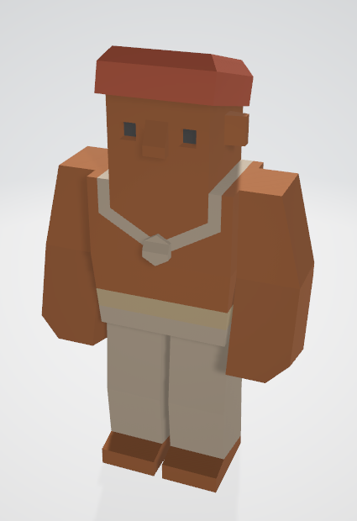
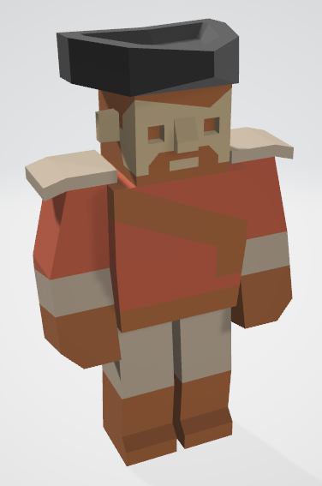
Level 6 – Group 3
Ship Happens
Tom Gibbs
Henry Crofts

Slide 2
Logline

Slide 3
Demographic

Slide 4
Psychographic

Slide 5
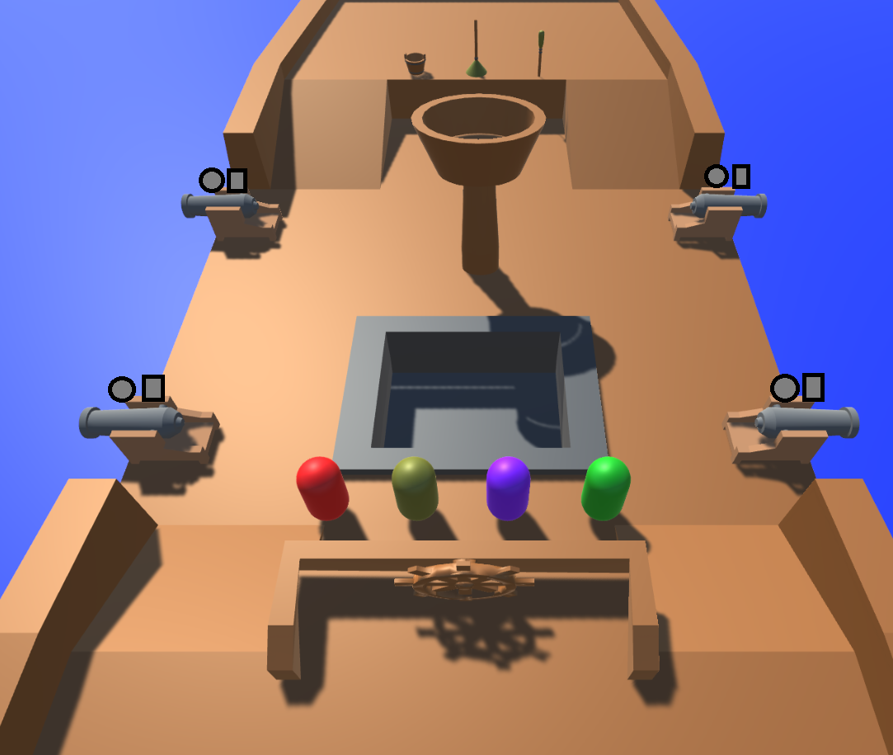
Tutorial: Start Mock-Up

Slide 6
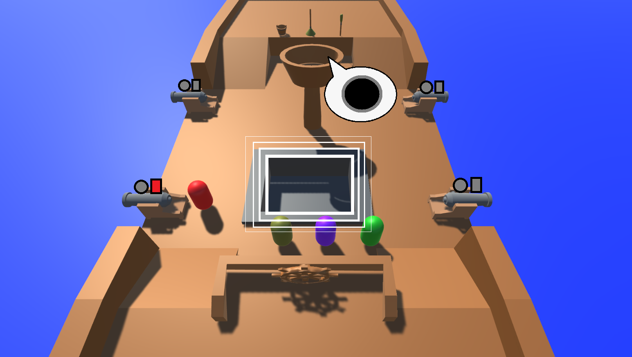
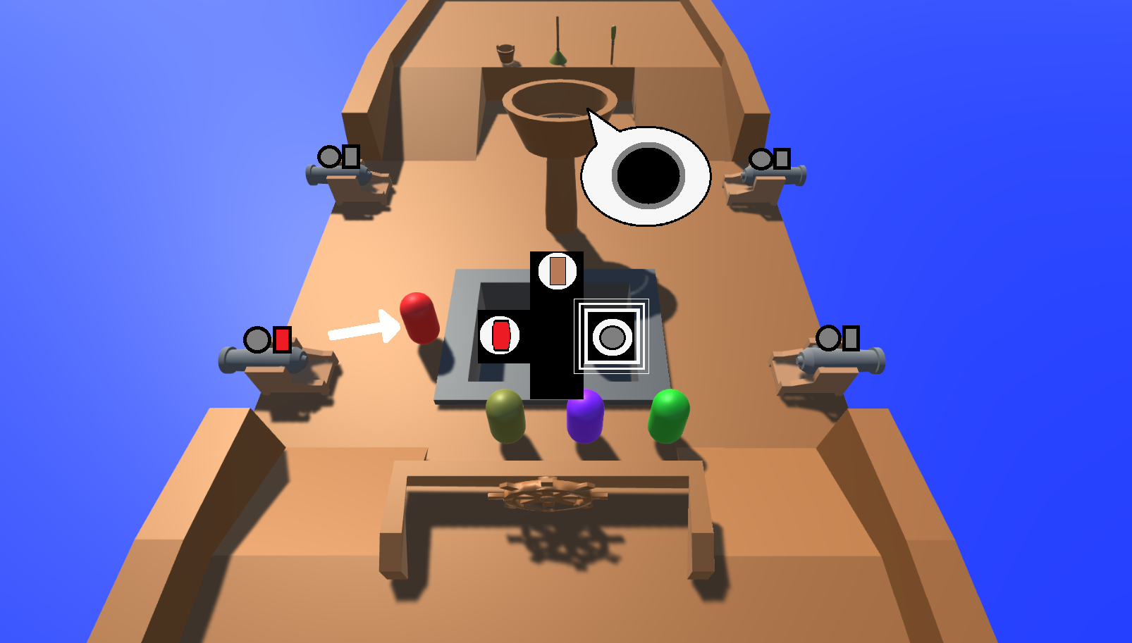
Tutorial: Cannonball & UI

Slide 7
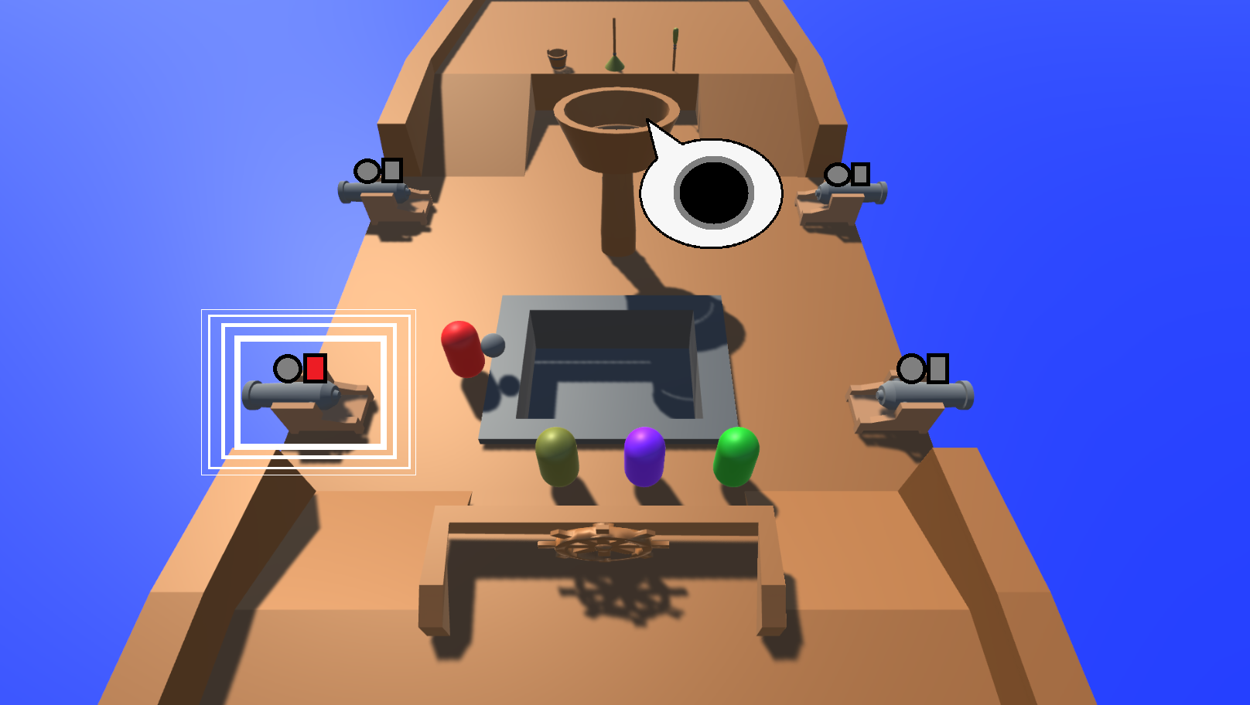
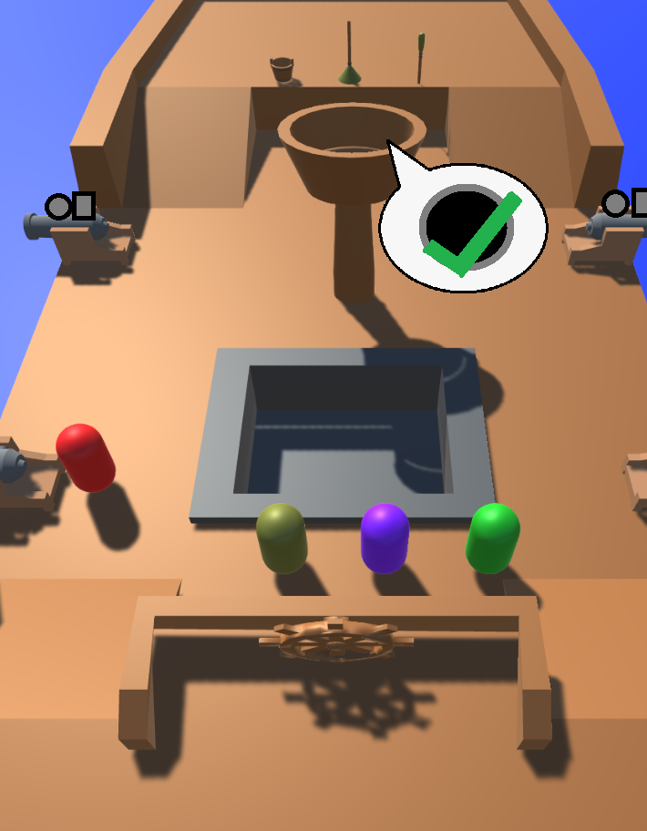
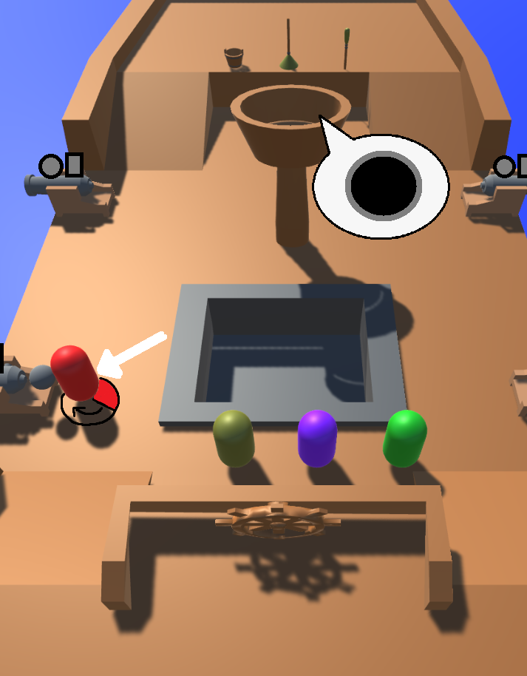
Tutorial: Load Cannonball

Slide 8
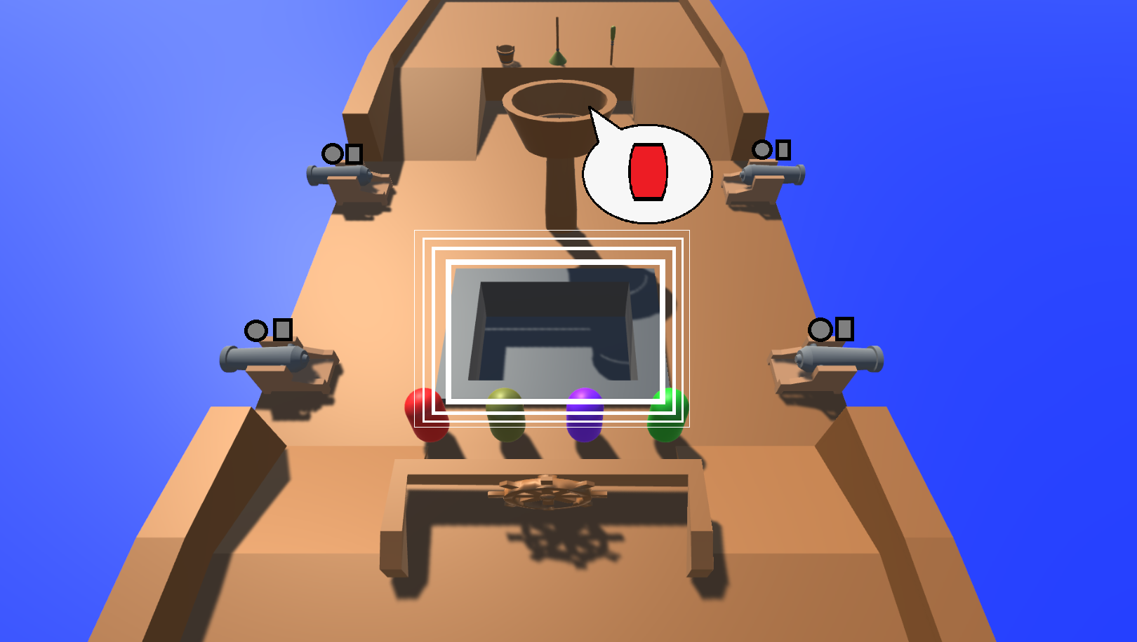
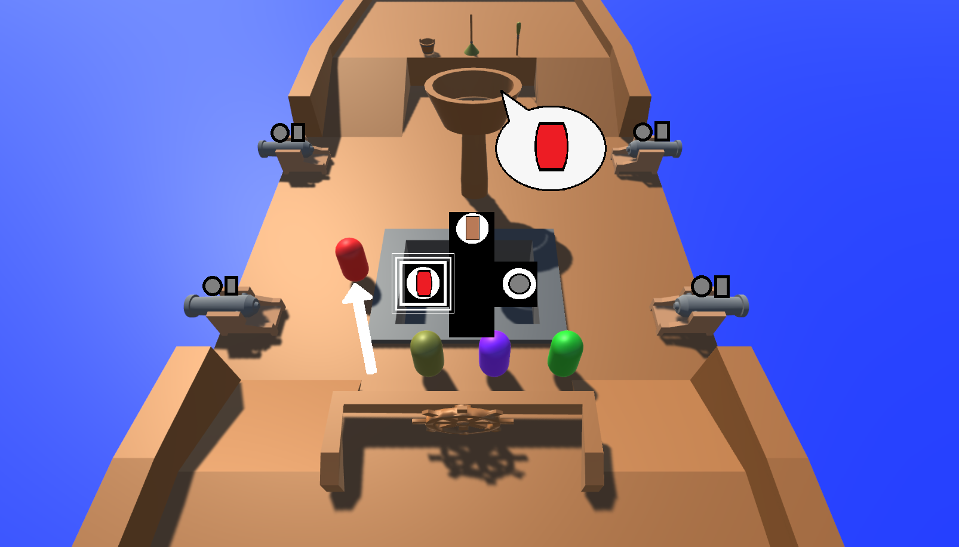
Tutorial: Gunpowder & UI

Slide 9
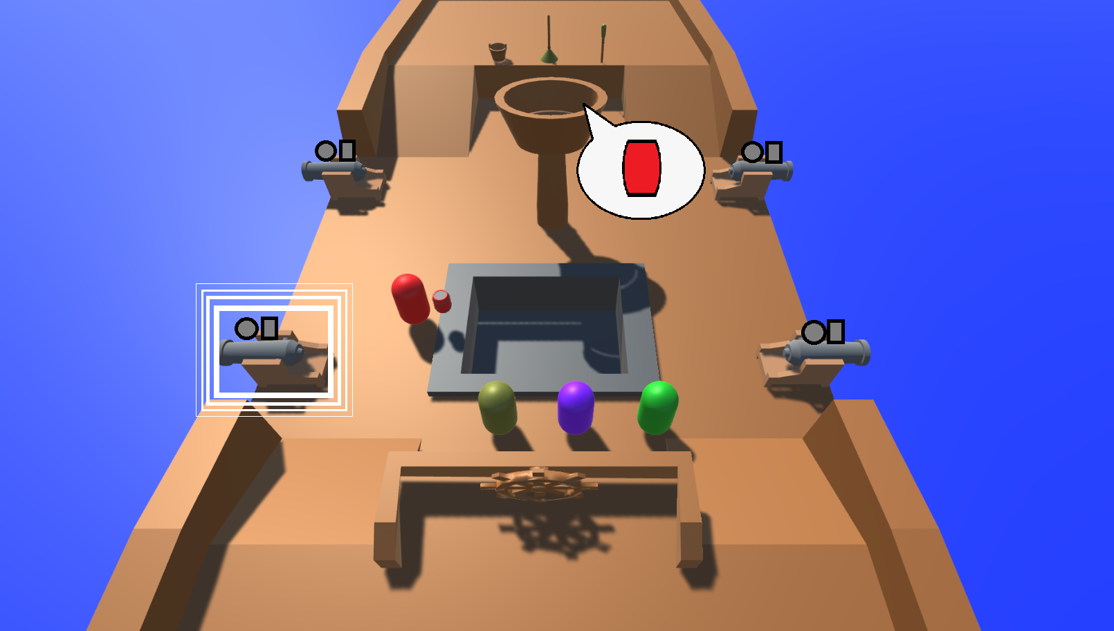
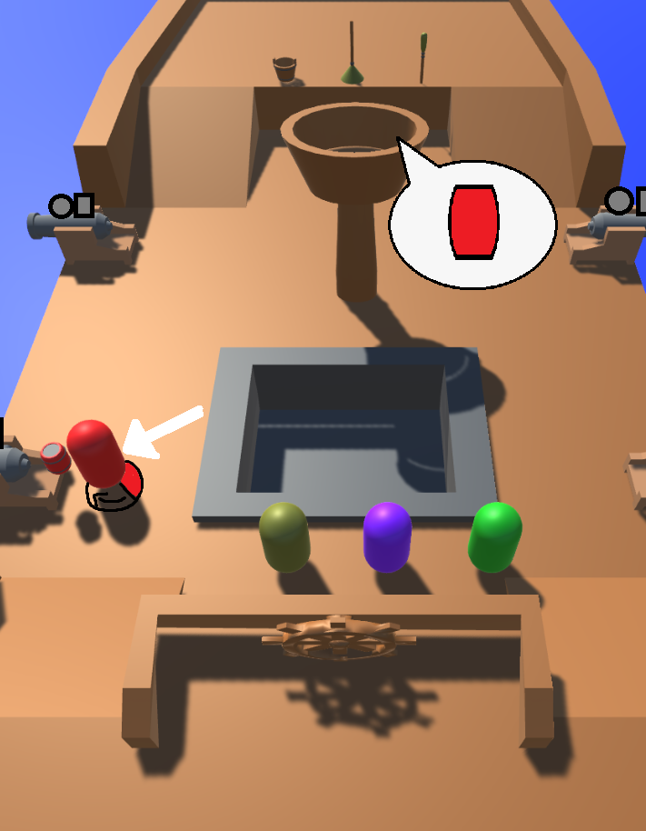
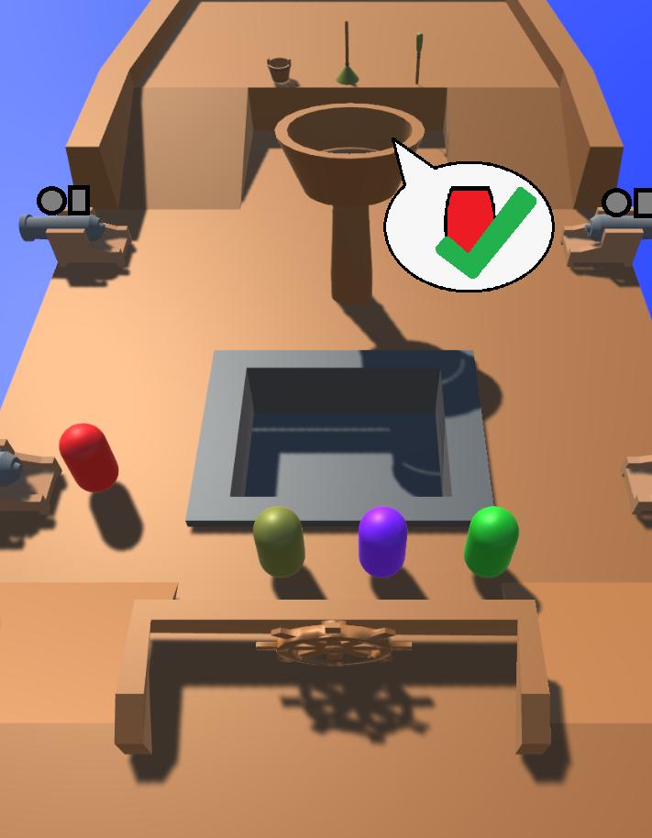
Tutorial: Load Gunpowder

Slide 10
Tutorial: Crow’s Nest Call Outs

Slide 11
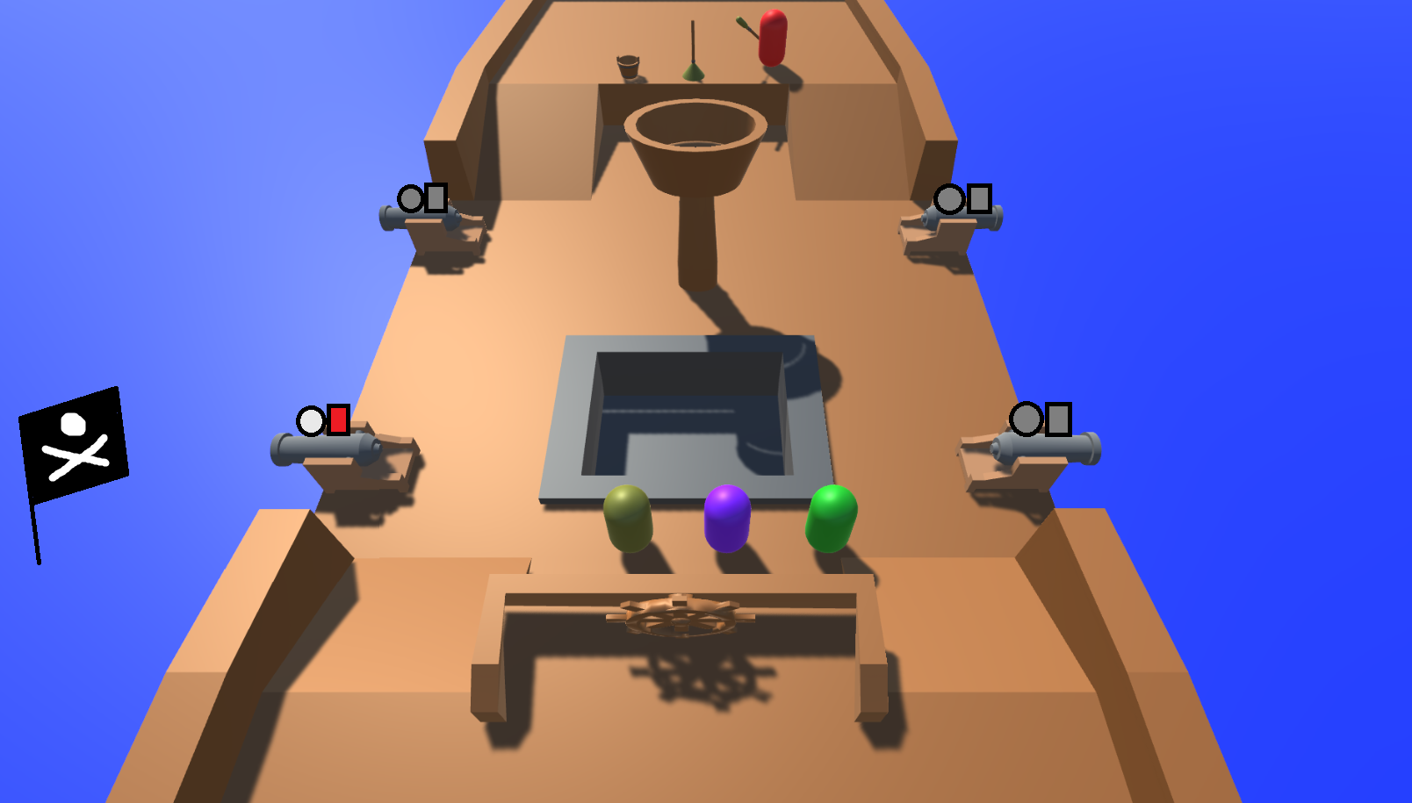
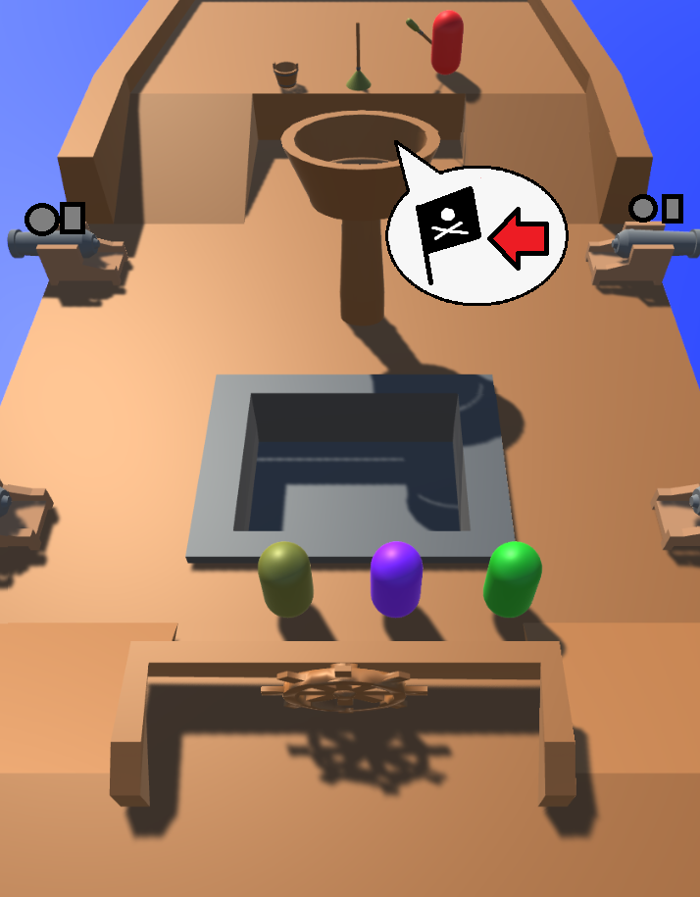
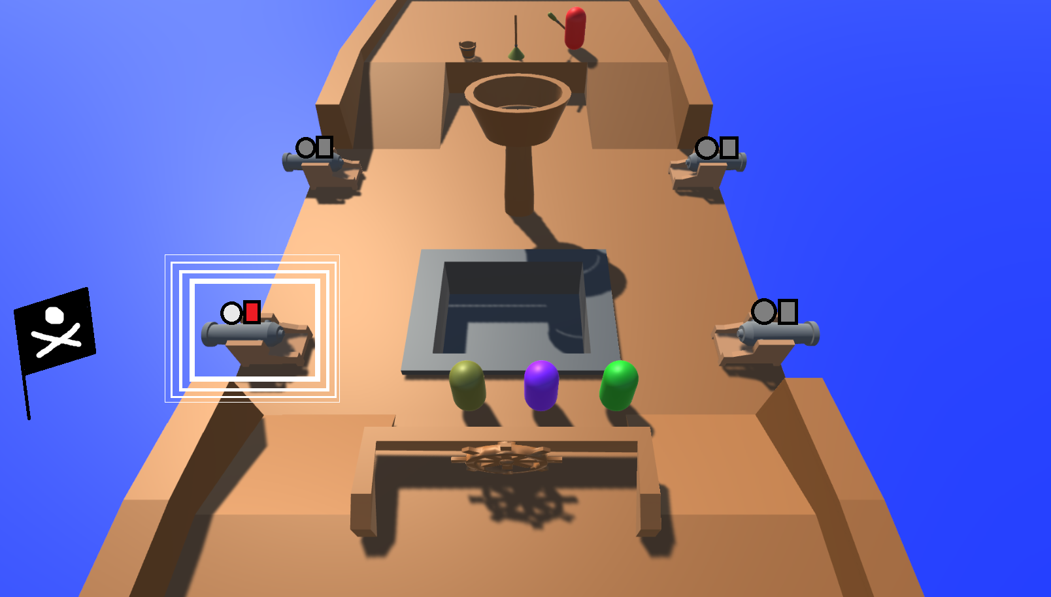
Tutorial: Show Enemy Flag Location

Slide 12
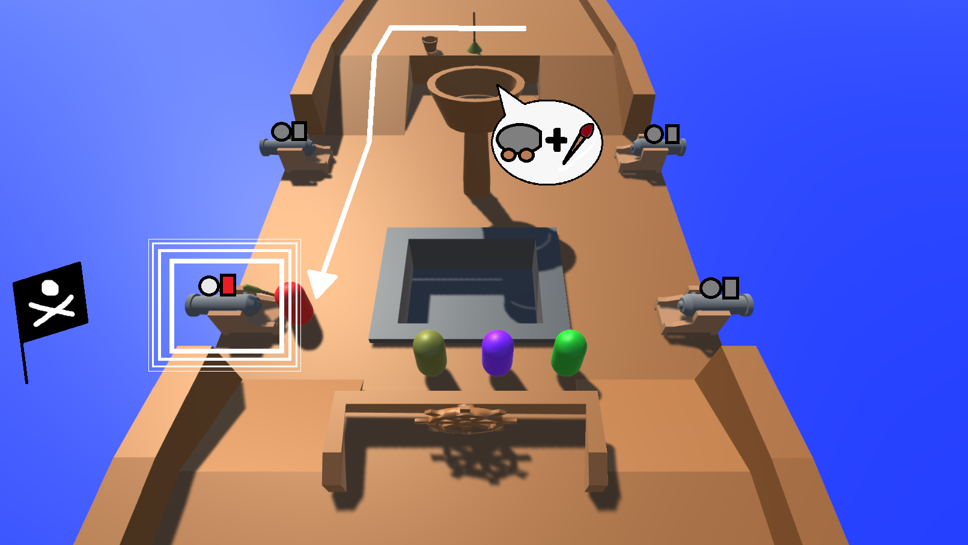
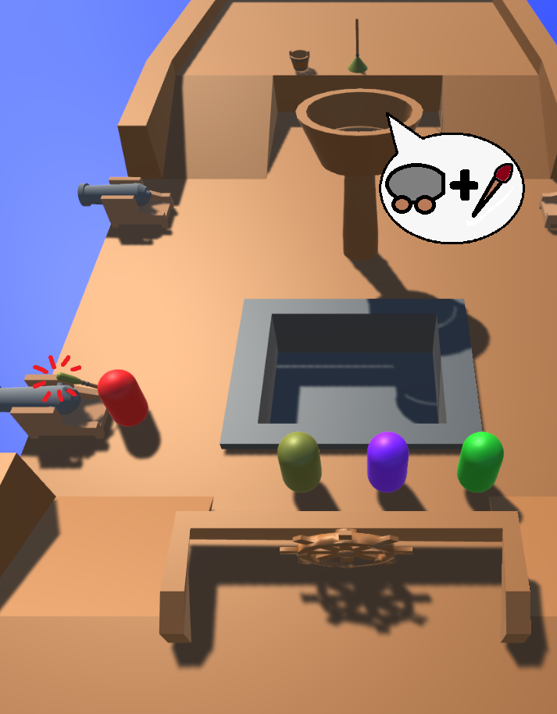
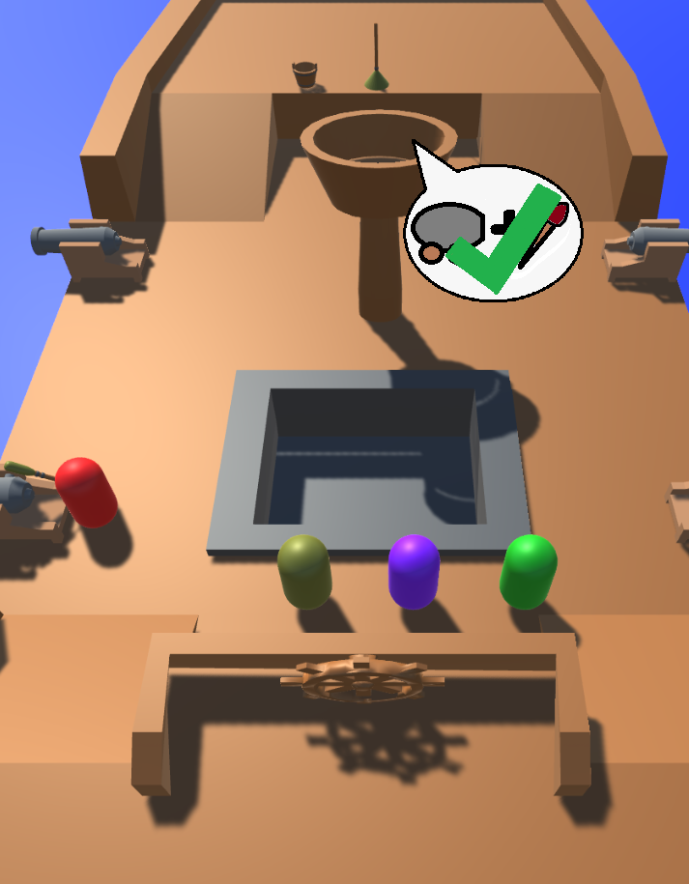
Tutorial: Cannon Firing

Slide 13
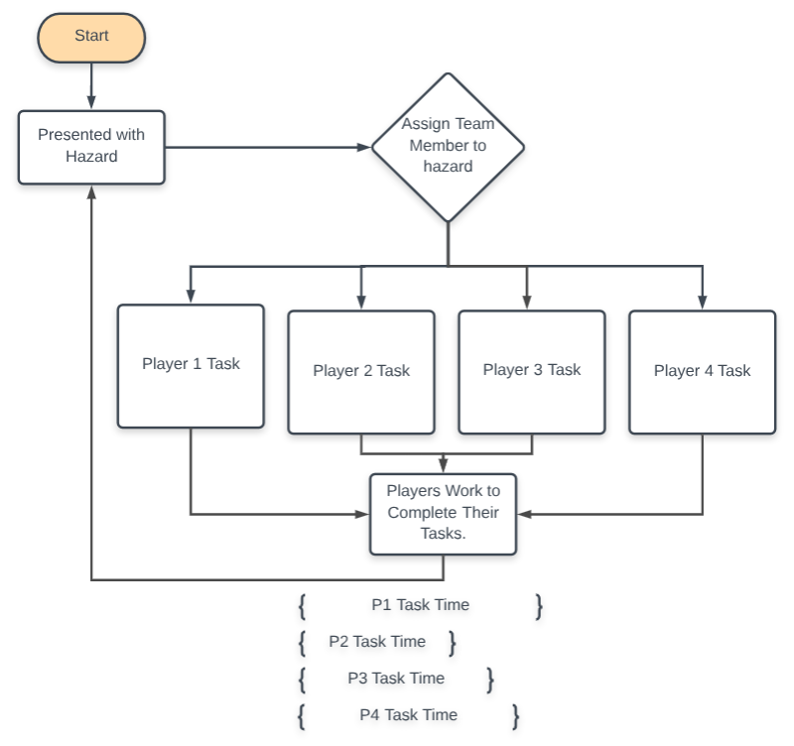
Flow Chart

Slide 14
Gameplay: 5 Seconds

Slide 15
Gameplay: 20 Seconds

Slide 16
Gameplay: 40 Seconds

Slide 17
Gameplay: 1 Minute

Slide 18
Gameplay: 2 Minutes

Slide 19
Gameplay: 5 Minutes

Slide 20
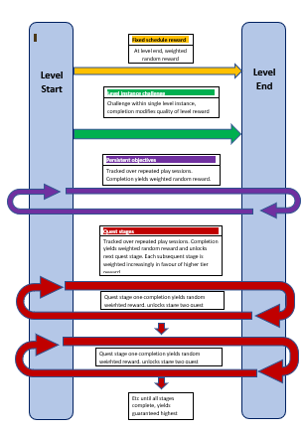
Reward Schedules

Slide 21
Milestones for Minimum Viable Product
Balancing
Code structure, interfaces
Player movement and interaction by (DATE)
UI
Action logic in objects
Player select and customisation (Placeholder assets)
Rewards
Tutorial paced correctly
Playtesting
Extra mechanics if not hard enough

Slide 22
Questions?

